Slide 1

PDA TO CFG CONVERSION
Submitted by
RAVI VAMSI KRISHNA [RA2111026010114] ASSVLY YASHWANTH [RA2111026010121] PSS VIVEK KARTHIK[RA21110260080] JAGARLAMUDI BIPIN [RA2111026010108]
Under the Guidance of
Dr. JEYASUDHA
Associate Professor, Department of Computational Intelligence
In partial satisfaction of the requirements for the degree of
BACHELOR OF TECHNOLOGY
in
COMPUTER SCIENCE ENGINEERING
with specialization in Artificial Intelligence & Machine Learning
SCHOOL OF COMPUTING
COLLEGE OF ENGINEERING AND TECHNOLOGY SRM INSTITUTE OF SCIENCE AND TECHNOLOGY KATTANKULATHUR – 603203
NOVEMBER 2023

Slide 2
OBJECTIVE OF PROBLEM:
The standard construction to convert a PDA into a CFG is usually called the triplet construction. In that construction the triplet [p,A,q] represents a computation from state p to state q with symbol A on top of the stack that (eventually) is popped.
Pushdown automata are an extension of finite automata with an added stack memory. The stack allows them to handle more complex behaviors. PDAs are commonly used for modeling and analyzing context-free languages and parsing techniques, such as the construction of parse trees and syntax analysis
APPLICATIONS:
For defining programming languages.
For parsing the program by constructing syntax tree.
For translation of programming languages.
For describing arithmetic expressions.
For construction of compilers.

Slide 3
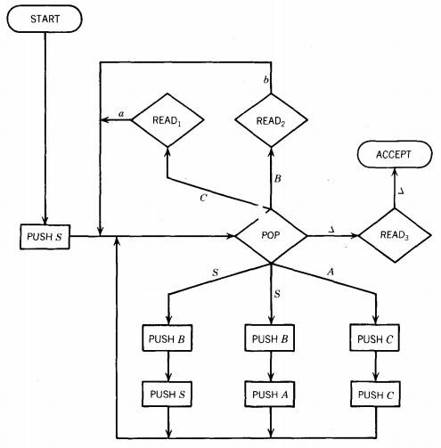
FLOW CHART:

Slide 4
PROCEDURE:
Converting a Pushdown Automaton (PDA) to a Context-Free Grammar (CFG) involves defining a grammar that generates the same language accepted by the given PDA. Here's a step-by-step procedure to perform this conversion:
Step 1: Understand the Components
Before you start the conversion, make sure you understand the components of a PDA:
Q: Set of states
Σ: Input alphabet
Δ: Stack alphabet
δ: Transition function
q₀: Initial state
Z: Initial stack symbol
F: Set of final states
Step 2: Define Variables and Terminals
Define variables for each state in the PDA and for each pair of states (q, r) where δ(q, a, X) contains (r, Y) in the transition function. Also, include variables for each stack symbol. Terminals correspond to input symbols and stack symbols.
Step 3: Start with Start Variable Create a start variable S.
Step 4: Convert Transitions to Grammar Rules
For each transition δ(q, a, X) = {(r, Y1), (s, Y2), ..., (t, Yn)}, add grammar rules of the form:
\[ qAX \rightarrow rY_1X \,|\, sY_2X \,|\, \ldots \,|\, tY_nX \]
If there are ε-transitions (transitions that don't read input symbols but change the stack), add rules like:
\[ qAX \rightarrow rY_1X \,|\, sY_2X \,|\, \ldots \,|\, tY_n \] for all transitions δ(q, ε, X) = {(r, Y1), (s, Y2), ..., (t, Yn)}.
Step 5: Handle Input Transitions
For each transition δ(q, a, X) = {(r, ε)}, add rules:
\[ qAX \rightarrow aX \]
This captures transitions that read input symbols and don't change the stack.
Step 6: Define Final State Rules For each final state q ∈ F, add rules:
\[ qA \rightarrow ε \]
This ensures that the PDA accepts when it reaches a final state.
Step 7: Define Start Variable Rule Add a rule for the start variable S:
\[ S \rightarrow q₀Z \]
Step 8: Simplify the Grammar
Simplify the grammar by removing unreachable symbols, epsilon productions, unit productions, and left recursion if necessary.
Step 9: Done
The resulting CFG now generates the same language as the original PDA.

Slide 5
EXAMPLE PROBLEM:
Q: {q0, q1, qf}
Σ: {a, b}
Γ: {a, b, Z0}
δ: Transition function
δ(q0, epsilon, epsilon) = {(q1, Z0)} δ(q1, a, epsilon) = {(q1, a)}
δ(q1, b, a) = {(q1, epsilon)}
δ(q1, epsilon, Z0) = {(qf, epsilon)} q0: Initial state
Z0: Initial stack symbol qf: Final state

Slide 6
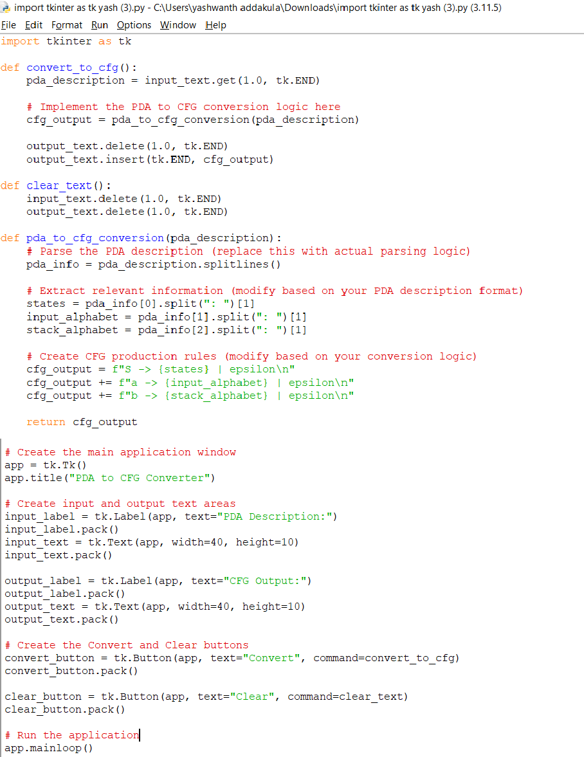
CODE:

Slide 7
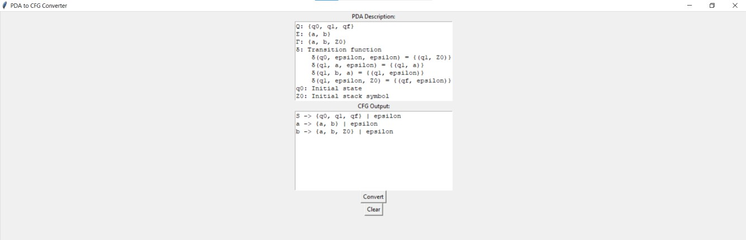
OUTPUT:
CONCLUSION:
In conclusion, converting a Pushdown Automaton (PDA) to a Context-Free Grammar (CFG) is a systematic process that allows us to represent the same language in a different formalism. By following the steps outlined in the conversion procedure, we can create a CFG that generates the language accepted by the given PDA. This conversion is valuable because it provides insight into the structure of the language recognized by the PDA and allows us to analyze its syntactical patterns.
It's important to note that while the conversion from PDA to CFG is possible, the reverse conversion (from CFG to PDA) is not always straightforward or guaranteed to be feasible. PDAs can recognize a broader class of languages than CFGs, including non-context-free languages. Therefore, the conversion from CFG to PDA may involve complex transformations or additional considerations, depending on the specific language being represented.
In summary, the conversion from PDA to CFG provides a valuable method for understanding and representing the language recognized by a pushdown automaton in the context of context-free grammars, enabling further analysis and manipulation of the language's syntactical structure.

Slide 8
CONTRIBUTION:
CODE: Yashwanth, Vamsi PPT: Vivek, Bipin

Slide 9
GITHUB LINK:
https://github.com/yashwanth-121/FLA-PDA-TO-CFG-/upload/main

